Slide 1

Mission Whisper: AI-Powered Astronaut Stress Monitoring System
ITAI 2372 – Conceptual Design Track
https://github.com/asamassekou10/NASA-Space-Mission-AI-Project
Alhassane Samassekou

Slide 2
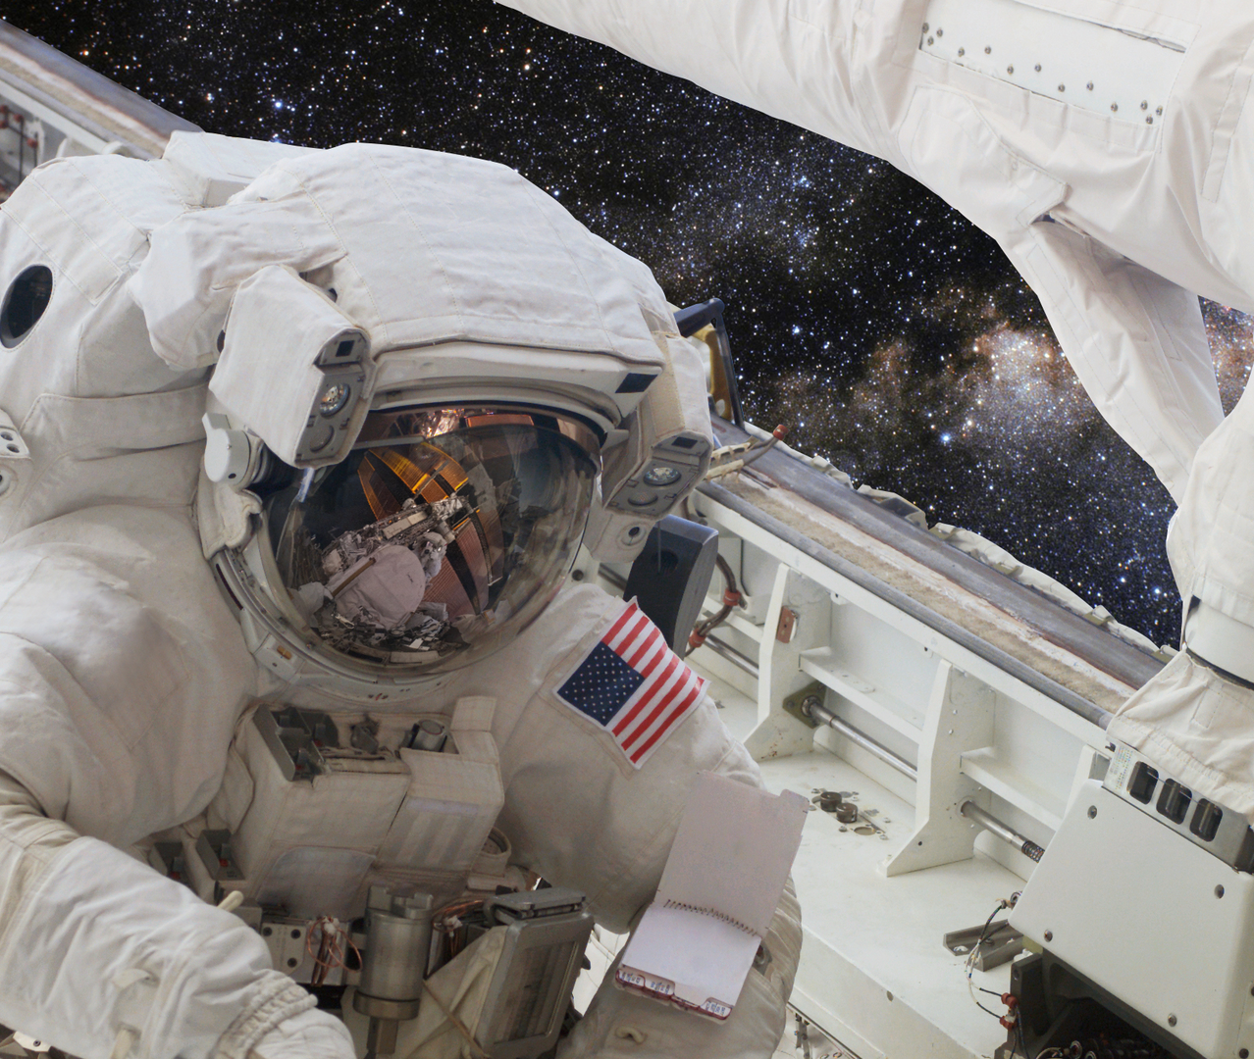
The Challenge: Astronaut Mental Health in Space
Long-duration missions cause psychological stress (isolation, high stakes).
Current tools rely on self-reporting, missing subtle distress signs.
Unchecked stress risks communication breakdowns and mission-critical errors.
Proactive stress monitoring is critical for mission safety and success.

Slide 3

Mission Whisper: AI for Stress Monitoring
AI system to monitor astronaut stress in real time.
Analyzes voice, facial expressions, biometrics, and text logs.
Alerts NASA flight surgeons, psychologists, and crews.
Goal: Enhance safety and performance on long missions.

Slide 4
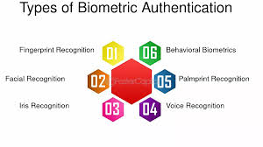
How It Works: Multimodal AI Monitoring
Non-invasive, continuous monitoring.
Real-time alerts for high stress levels.
User-friendly dashboard for mission control.

Slide 5
Technical Design: Data and AI
Data Sources:
Voice: Tone, pitch, speed (audio logs).
Video: Micro-expressions (camera feed).
Biometrics: Heart rate, skin temp, sleep (wearables).
Text: Sentiment in mission logs/journals.
AI Methods:
Voice: CNNs/transformers for emotion recognition.
Video: ResNet for facial analysis.
Biometrics: Random Forest for stress classification.
Text: BERT for sentiment analysis.

Slide 6
System Architecture
Sensors (wearables, cameras) → Data Preprocessing → AI Pipelines (audio, video, biometric, text) → Risk Score Aggregation → Dashboard/Alerts.
Preprocessing: Cleans noisy data (e.g., audio filtering).
Risk Score: Combines outputs for a 0–100 stress score.
Dashboard: Real-time visualization using Streamlit.

Slide 7
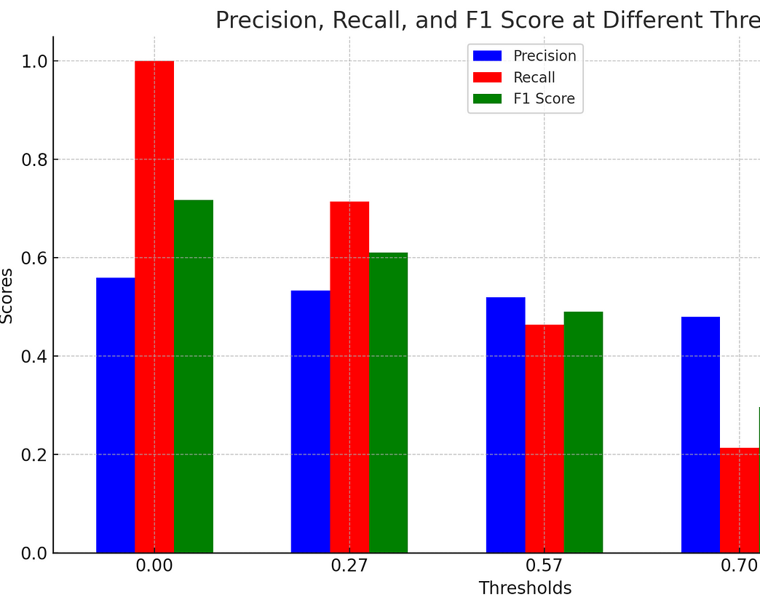
Testing Plan
Unit Testing: Validate each AI model (voice, video, biometric, text) on labeled datasets.
Simulation Testing: Test system with mission-like scenarios (e.g., high-stress events).
Metrics: Accuracy (>85%), F1 score (>0.80), low false positives.Validation: Human-in-the-loop review by psychologists; threshold tuning.

Slide 8
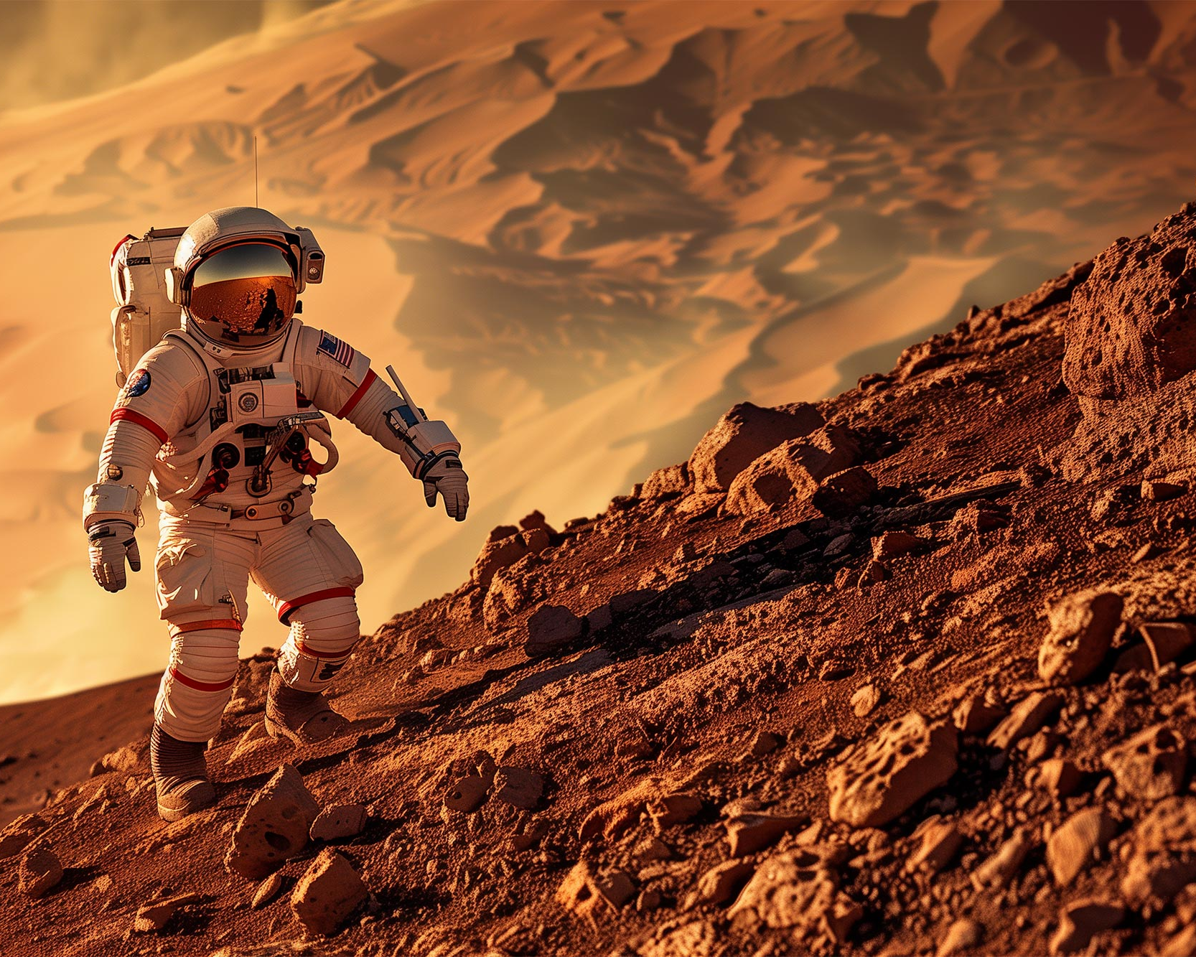
Why Mission Whisper Matters
Enhances astronaut safety and mission success.
Proactive mental health support for long missions (e.g., Mars, lunar outposts).
Scalable for future space exploration.
Empowers flight surgeons and psychologists with data-driven insights.

Slide 9
Conclusion
Mission Whisper: A proactive AI solution for astronaut stress.
Ready to support NASA’s future.
Comprehensive design with rigorous testing.
Alhassane Samassekou

Slide 10

THANK YOU
Alhasasne Samassekou
ITAI 2372 – Conceptual Design Track
Github link: https://github.com/asamassekou10/NASA-Space-Mission-AI-Project

